Slide 1
GROUP 3
KYAMANYWA REGAN RONALD | 21/U/11649/PS
GABANGULA ISSA | 21/U/3885
EKIYASIIMIRE BELIEVE | 21/U/0908
KAYAGA BENITOR MUKISA | 21/U/13699/PS
KARUNGA ANGEL | 21/U/04687/PS

Slide 2
DISCUSSION POINTs
a) Explain the major steps in the enterpreneurial process
b) What is an opportunity? differentiate between an opportunity and idea. Describe the role of opportunity in the enterpreneurial process
c) Explain examples of potential business opportunities.
d) Describe the three generic approaches for identifying opportunities.
e) Discuss the key process of opportunity recognition.

Slide 3
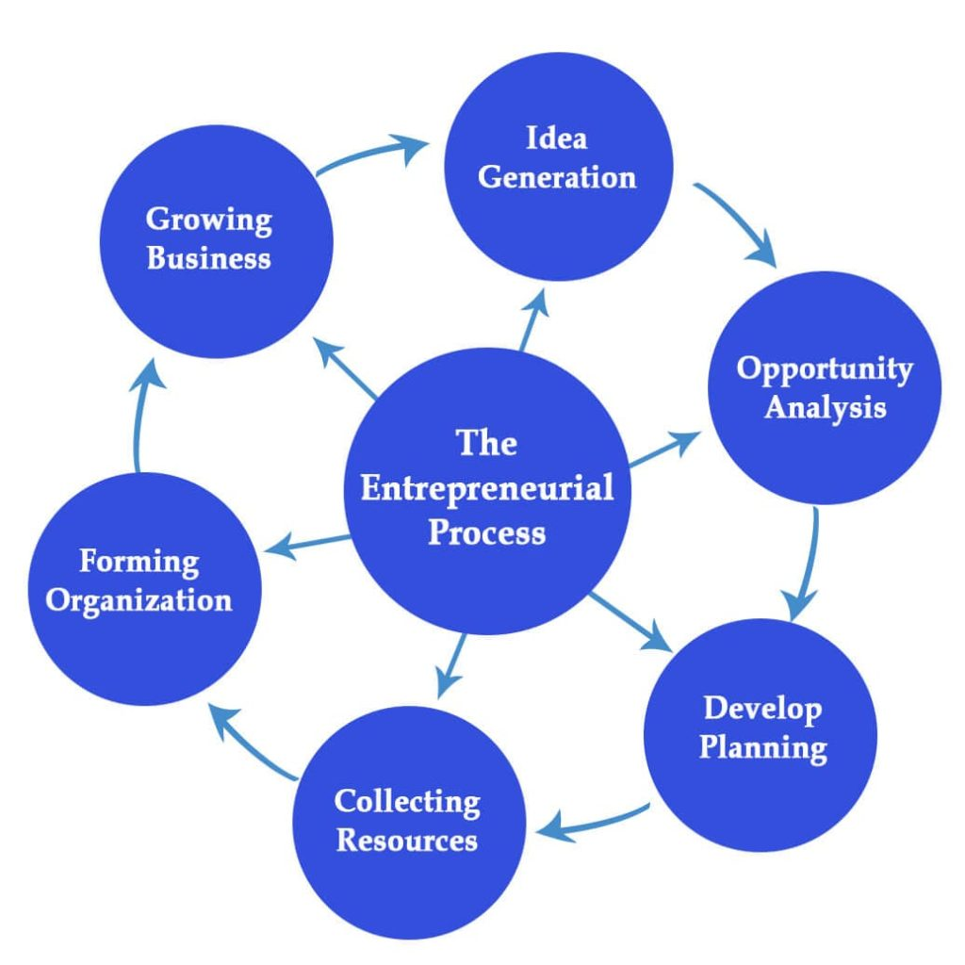
Entrepreneurial process
Entrepreneurship process is a course of action that involves all functions, activities and actions associated with identifying and evaluating perceived opportunities and the bringing together of resources necessary for the successful formation of a new firm to pursue and seize the said opportunities.

Slide 4
The processes
1.Idea Generation
This is the first step in the entrepreneurial process. An idea can be a problem or solution. Here, the entrepreneur identifies an idea worth pursuing. The entrepreneur conducts the feasibility study and take input from other stakeholders.
Note: the feasibility study is aimed at evaluating the viability of the opportunity financially, technically etc

Slide 5
2. Opportunity generation
Focuses (6)
After identifying the opportunity, the entrepreneur will evaluate it. They will see if the opportunity provides any value to the business or the consumer, whether it will be sustainable in the long term if the profit is healthy, the market competition, the risks associated with the opportunity, and the entrepreneur’s product or service will be different or better than the competition.
Is the opportunity worth investing capital, resources, and energy?
Can we offer better solutions than existing ones?
Can we beat the competition?
Is the business sustainable in the long run?
What are the risks?
If the answers are generally positive, entrepreneurs move to the next step.

Slide 6
3.Developing a Plan
After analyzing the opportunity, the entrepreneur develops a plan to realize it and launch the company. This is a crucial step in the entrepreneurial process. The plan will have a business strategy and operating structures, including steps for the formation of the company.
It will provide details on business
Objectives
goals
mission statement
details of products or services.

Slide 7
4.Collecting Resources
Launching a new business requires resources, including financing, human labor, materials, and more. If the entrepreneur is self-sufficient, they can self-finance. However, they may go to investors or financial institutions to get the funds.
Thru;
crowdfunding. Using these platforms, entrepreneurs raise awareness about their business and ask for support. If the idea resonates with the audience, businesses can quickly raise a significant amount.
Other sources off funding

Slide 8
5. Forming Organization
Once the entrepreneur secures the funds and resources, they will launch the company and form a legal entity. The structure of the organization will depend on its requirements.
The entrepreneur will name the company and file the papers with the government to form a;
LLC(Limited Liability Company)
WLL or Public Limited Company(PLC)
Corporation
or a Non-profit.

Slide 9
6.Growing the Business
After launching the company, it will start producing products or offering services. The entrepreneur will ensure that the business is running smoothly and growing. Now the operating plan will be executed. The entrepreneur will have regular status updates and compare the actual progress with the planned progress. If things are not going as planned, they will take corrective actions to bring the progress on track.

Slide 10
B) The business opportunity
An opportunity is an identified chance that can be turned into a profitable business.
It’s at a point at which identifiable consumers’ demand meets the feasibility of satisfying the requested product or service. I can be an idea that can be implemented, for which resources are available that will prosper.

Slide 11
Characteristics of a business opportunity
Should be on real demand
Should be competitive
Acceptable in the community
Should meet government policies
Should meet the entrepreneurs goals and objectives

Slide 12
Differences between a business idea & opportunity
An opportunity is an identified chance that can be identified into a profitable business
Whereas,
An idea is a response of a person or an organization to solve an identified problem or meet the needs in the community.

Slide 13
Sources of Business ideas
Newspapers
Magazine articles
Trade shows and exhibitions
Brain storming

Slide 14
Roles of business opportunity in the entrepreneurial process
serve as the basis for any action that results in profit and business growth
allow businesses to create and implement ideas and innovations and improve their performance.
To provide customer relationships.
To bring dynamics of economic development in the society stems from the actions of the entrepreneur starting new business ventures or make existing firms grow
references; Aidrich, H. (1999).Organisatios Evolving, London:sage.

Slide 15
c) Explain examples of potential business opportunities
Franchising. This is one of the most commonly found business opportunities in the industry. with franchising, the business plan and road map will be prepared ahead of time.
Marketing. Here, the focus is on network marketers who put together plans that can be used to recruit fellow marketers and as a result, a huge pyramid of marketers is created. In this, network, products, services and ideas can be sold.
Takeaway. This business opportunity in entrepreneurship aims at providing long-term partnerships and revenues. These opportunities include; management and negotiation skills.

Slide 16
continuation
Distributorships. A distributorship involves entering into an agreement to offer and sell the products of another without being entitled to use the manufacturer’s trade name. depending on the agreement, the distributor may be limited to selling only that company’s goods or may have the freedom to the market several different product lines
Drop shipping business. This is one of the best at-home business opportunities that lets you buy products directly from a supplier or manufacturer and ship them to customers.
Consulting. Consulting is one of the most common business opportunities that help a broader range of people with a specific skill for example Facebook Ads expert who educates business people on how to run effective Facebook ads.

Slide 17
continuation
Freelancing. In freelancing, you practice your skill for the business. Freelancing is an ideal business opportunity to pursue from home as it often entails remote work such as writing, graphic design, photography among others
Blogging. This is popular because it gives you the opportunity to create many potential sources of income. Bloggers often make money from affiliate marketing, ads, information products, physical products among others
Housekeeping business. These include housekeepers and cleaners which are hired by people in major cities to keep their homes clean and tidy while they are at work
Direct selling. The practice involves selling products not generally available in retail stores directly to customers. with rising need for supplemental income, recruiting new members is easier

Slide 18
continuation
Customer support. Customer service is a service that many companies require. You can start your own business-like customer service, managing other companies’ issues with customers via phone, email or chat.
Digital products. E-learning is exploding as an industry, making digital products one of the best online business opportunities for creators and educators alike. They can be held or touched but are popular amongst customers because they can download them and consume on their own time.

Slide 19
D) THE GENERIC APROACHES TO IDENTIFYING OPPORTUNITIES
Cost leadership
Differentiation
Focus

Slide 20
Cost leadership
This involves minimizing the costs incurred in the business in terms of providing value i.e. products and services to customers. Cost leadership uses large scale production, cuts costs and uses economies of scale.
NB: Economies of scale refer to proportionate savings in costs gained by an increased level of production.
Advantages and disadvantages
Advantages.
It provides better profits for the organization.
it can increase an organization’s market share

Slide 21
Advantages cont’d
It improves the sustainability of the business.
Disadvantages
Reduces product innovation
Limits the importance of consumer feedback
Requires time and purpose of market research

Slide 22
DIFFERENTIATION APPROACH
This strategy involves nothing but an approach that pushes organizations to develop unique features for their products and services as compared to their competitors.
Aim: To gain a competitive edge and earn greater reputation in the target market. To accomplish this, the organization or business must know its strengths, weaknesses and customer preferences or needs.

Slide 23
Advantages and disadvantages
Advantages
Reduced price competition
Product uniqueness
Increased profit margins
Customer loyalty
Disadvantages
It can strain the resources
Challenge of changing the customer perception.

Slide 24
FOCUS APPROACH
This is a method of developing, marketing and selling products to a niche market, which could be a type of customer, product line or geographical area.
. A niche market is a segment of the market on which a specific product is focused, is defined by its own needs and preferences. For example Shoes for Vegan women or men.
Aim: The main aim of the focus strategy is to exploit undeserved or undiscovered segments of a target market.

Slide 25
Focus cont’d(cost and differentiation)
Cost focus involves a firm seeking a cost advantage in its target segment
Differentiation focus involves a firm seeking to outperform its rivals through offering unique products for its target segment.

Slide 26
Advantages and disadvantages
ADVANTAGES
It helps to build strong relationships with each target market
It brings expertise into the products or services
It may limit the competition
DISADVANTAGES
It may limit the initial demand of a product or service
It offers lower equipment utilization rates

Slide 27
E) Opportunity recognition.
Opportunity recognition is a process when individuals and organization actively seek out as well as perceive, opportunities for new products and services.
Or
Is a step by step procedures of how an entrepreneurship identifies an opportunity and makes it a viable business idea.

Slide 28
The opportunity recognition process
a) Getting the idea; The first stage is for the entrepreneur is to get the business ideas. An individual can generate a business idea from a ninche in the market. A niche is a gap left unfulfilled by those currently serving the market. It provides a chance for other people to add value that was unmet. It allows the new entrepreneurs to perform differently and compete with already existing business.
b) Identifying the opportunity; Opportunity identification is when an individual realizes a business idea with good returns that has not been discovered. It requires keen scanning of the business environment, being alert about the changing information and the ability to use the information effectively.

Slide 29
continuation
c)Developing the opportunity; Developing an opportunity requires the entrepreneur to modify the idea to suit the current market needs. During this stage, research is conducted to identify whether the business idea can be converted into an actual business.
D) Evaluating the opportunity; Opportunity evaluation is the stage where the potential risks are assessed. It is identified whether the risks will be worth the investments made. Profitability is also scrutinized to find out how long the payback period is after an investment.
e) Evaluating the team; The final stage involves having a skilled team to bring the business idea to realization. Employing capable people who will work to make the opportunity economically viable

Slide 30


